Slide 1

期末報告
生成型深度學習
Generative Deep Learning
測試報告

Slide 2
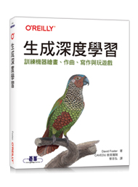
生成型深度學習 Generative Deep Learning
CycleGAN
Paint
Neural Style Transfer
Write
LSTM Network
Compose
RNN
MuseGAN
VAE(2013- )
GAN(2014- )
Play
MDN-RNN

Slide 3
生成型深度學習 Generative Deep Learning:
An experience

Slide 4
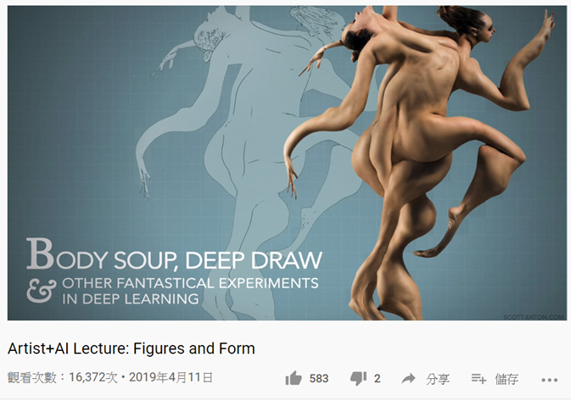
AI Art
Artist+AI Lecture: Figures and Form
https://www.youtube.com/watch?v=TN7Ydx9ygPo

Slide 5
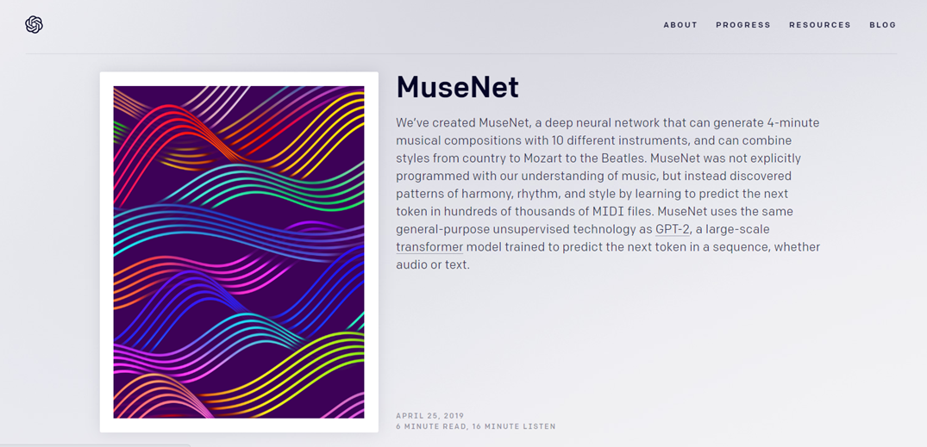
AI Music: Open AI
https://openai.com/blog/musenet/

Slide 6
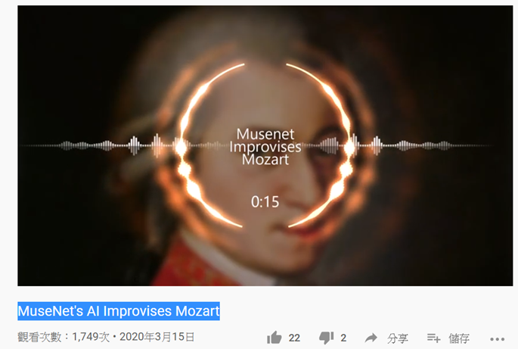
MuseNet's AI Improvises Mozart
https://www.youtube.com/watch?v=c6DK8IKS9z4

Slide 7
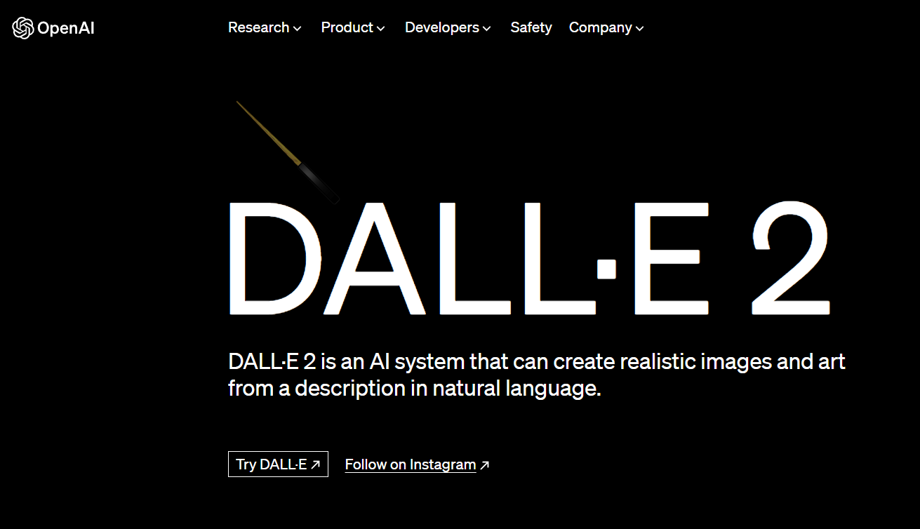
https://openai.com/product/dall-e-2

Slide 8
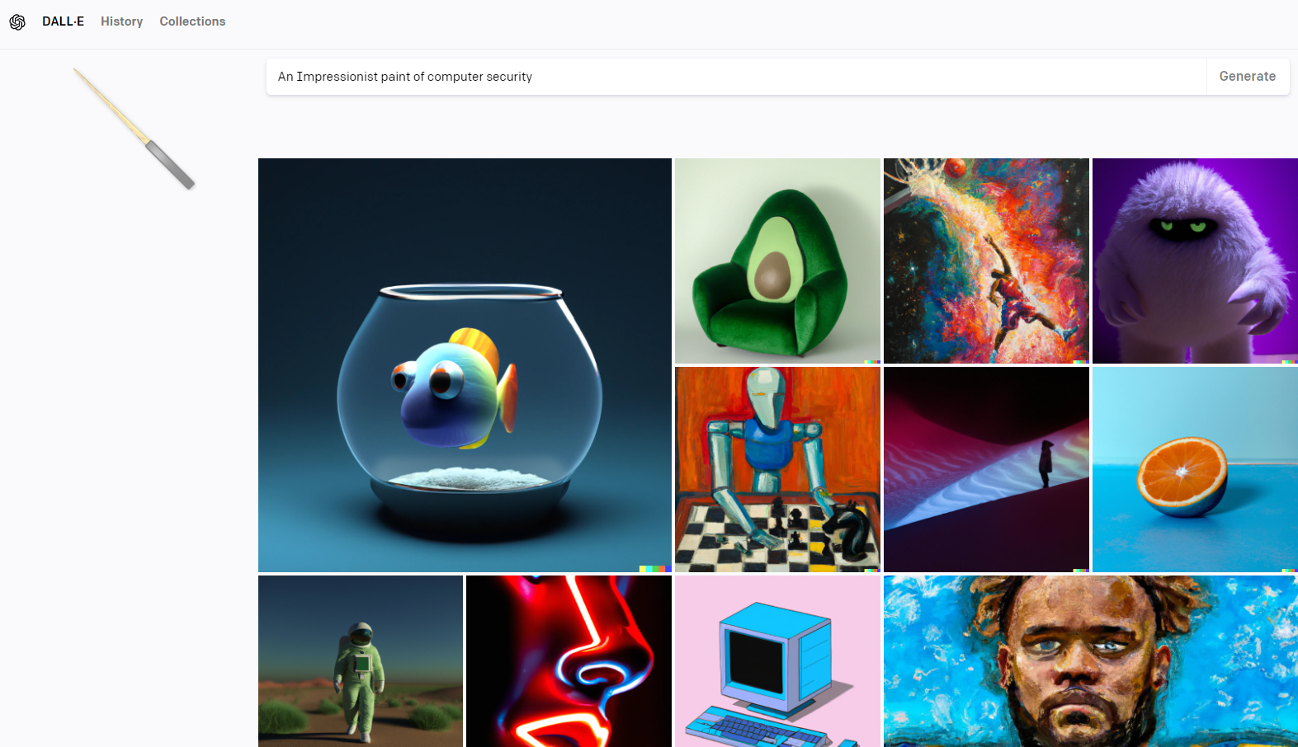

Slide 9
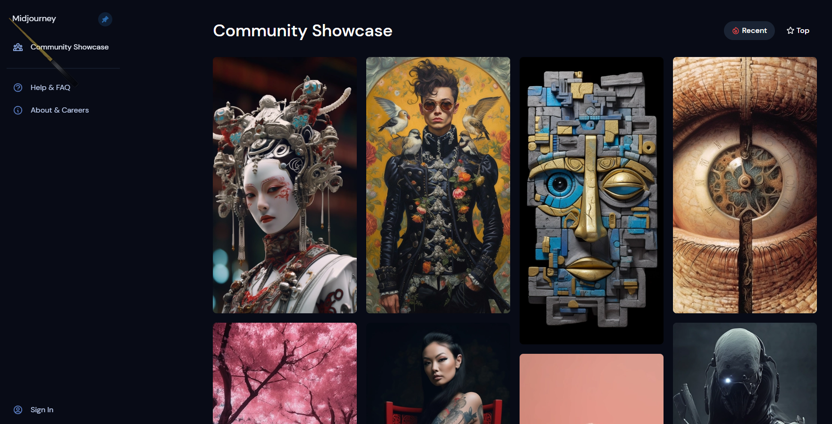
Midjourney

Slide 10
Midjourney

Slide 11
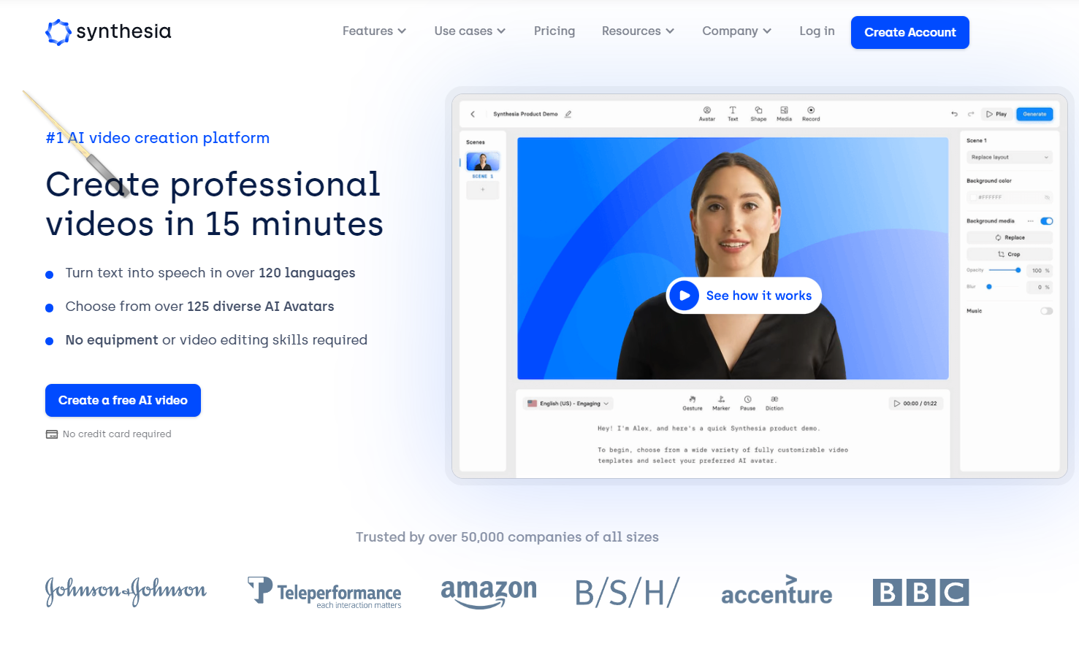
https://www.synthesia.io/

